Slide 1
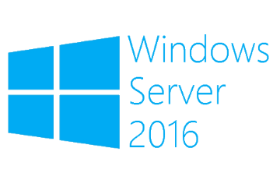
Hyper-V shared disks
Megaseries

Slide 2
Introduction
New addition in Windows Server 2012 R2 with new features in Windows Server 2016
Allows you to create virtual hard disks that can be used by multiple VMs at the same time making it possible to create guest clusters on Hyper-V
Attached to the SCSI controller and seen in the VM OS as a shared SAS drive
Files must be placed on a CSV or an SMB share where the server has SMB 3.02 and shared VHDX components support

Slide 3
VHD Set
New shared virtual disk format introduced in Windows Server 2016 with a new file type: VHDS
Can be resized online, support replication and can be included in application-consistent snapshots
Existing shared VHDX files can be converted to VHDS but must be disconnected from VMs

Slide 4

https://www.youtube.com/channel/UCcZ-jLbPwNr8E_v9-65n8Iw https://github.com/itknowledge4

